Slide 1
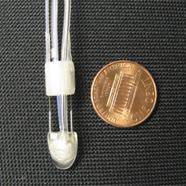
HeartLander
Picture - http://www.cmu.edu/homepage/innovation/2007/summer/bot-moves-with-the-beat.shtml

Slide 2
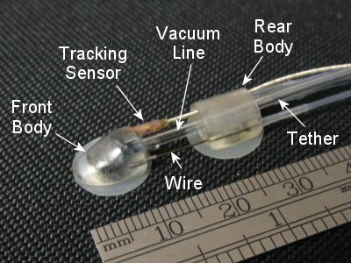
Characteristics
Size – Penny sized
Movement – worm-like
Manipulate – Tool port
Sensing – Tracking sensor
Think – Semi-autonomous Movement
Picture - http://www.cs.cmu.edu/~./heartlander/design.html#Locomotion

Slide 3
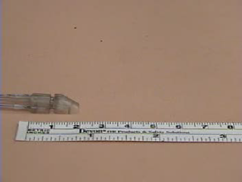
Video - http://www.cs.cmu.edu/~./heartlander/videos.html

Slide 4
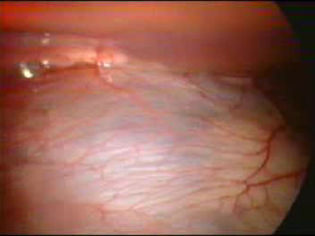
Video - http://www.cs.cmu.edu/~./heartlander/videos.html

